Slide 1
TPGES Overview
2015-16

Slide 2
Objective
Overview/Review the Teacher Professional Growth and Effectiveness System (TPGES) components
(with emphasis on CEP expectations for 2015-16)

Slide 3


Jefferson County Public Schools Certified Evaluation Plan Revised August 12, 2015 Educator Quality Oversight Committee (EQOC) John Ansman, Evaluation Transition Coordinator (R-5) Tiffeny Armour, ARD Director – Chair Beverly Chester-Burton, Teacher (Stuart Middle School) Margie Eckerle, Evaluation Transition Coordinator (R-6) Jo McKim, Teacher (Central High School) Marty Pollio, Principal (Jeffersontown High School) Tony Prince, Teacher (Atherton High School) Faith Stroud, Principal (Robert Frost 6th Grade Academy) Royce Whitman, Teacher (Crums Lane Elementary School) Alan Young, Teacher – Project Manager

Slide 4
JCPS Certified Evaluation Plan
Required by KDE
Developed by the Educator Quality Oversight Committee (EQOC – 50/50 Committee)
Approved by JCTA & JCBE
Submitted to KDE for accuracy and compliance
TPGES - Full Implementation with accountability for personnel decisions
OPGES – Full Implementation without accountability

Slide 5
PGES Vision
Every student taught by an effective teacher and every school led by an effective leader

Slide 6
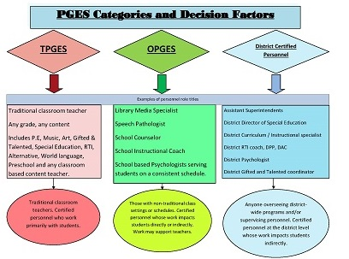

Slide 7
PGES Model for Summative Evaluation of Teachers
PROFESSIONAL
PRACTICE
STUDENT GROWTH
OVERALL PERFORMANCE

Slide 8
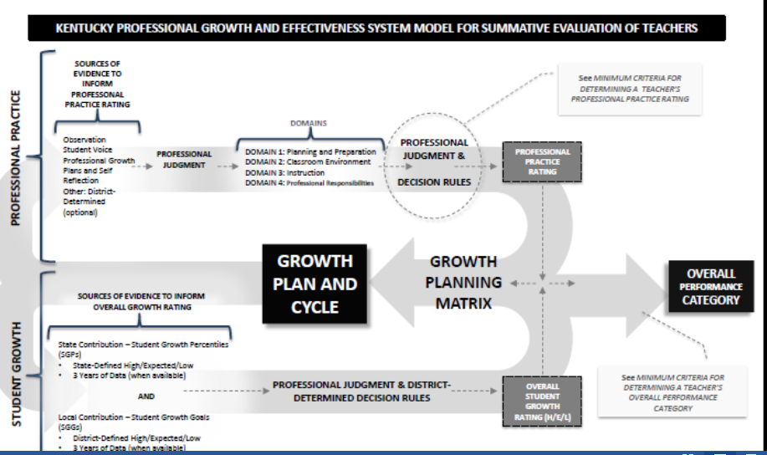
Notes:
Talk about the big picture and how an overall performance rating is achieved. Not too much time.

Slide 9
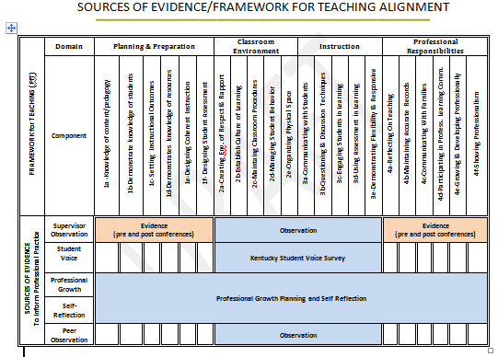
Sources of Evidence/ Framework for Teaching Alignment

Slide 10
Teacher
Professional Growth
and Effectiveness System
Observation
Student Voice*
Peer Observation - formative
Professional Growth Plan
Self-Reflection
Sources of Evidence to Inform Professional Practice
Notes:
Student growth is only one of the sources of evidence, but it is important to keep in mind that it is also the important outcome of the whole system. Teacher effectiveness should result in student learning. Observation – minimum of 4 observations- check CEP for directions of how many full and minis and the schedule for one year and three year summantive. Student Voice is off the table now for preschool through 2nd grade.

Slide 11

Notes:
This Danielson Framework is the document that preschool teachers self-reflect.

Slide 14
PGES is Evidence-based
-Evidence is based on what we see, hear, read.
Note the importance of using “Rich” artifacts.
A few excellent artifacts is preferred to a bulging binder of “so-so” artifacts.

Slide 15
A rich artifact. . .
A well-written, detailed lesson and/or unit plan would provide rich evidence for many elements and indicators in Domain 1 – Planning and Preparation

Slide 16
In Domain 4
Teachers, in collaboration with their principal, will determine what evidence they will provide to demonstrate effectiveness for Domain 4. Again rich artifacts can address many components and criteria in Domain 4 – Professional Responsibilities
(The principal may request additional evidence if needed.)

Slide 17
Domains 2 and 3
Will be addressed more directly later under the PGES Professional Practice Source of Evidence Observation.

Slide 18
So Let’s Start With Professional Growth:
Self-Reflection and Professional Growth Plans

Slide 19
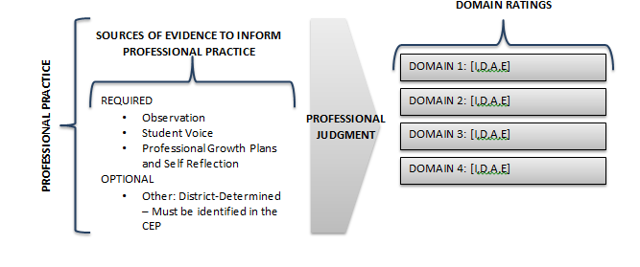
Notes:
This chart in the Model Certified Evaluation Plan created by KDE shows us how evidence of professional practice will result in ratings in each of the Domains of the Framework for Teaching. Notice on the left that there are several sources of evidence for this, including observation, student voice, professional growth plans and self-reflection. Also, notice that districts can also identify other sources of evidence as appropriate.

Slide 20
Definitions
Self-Reflection: The process by which certified personnel assesses the effectiveness and adequacy of their knowledge and performance for the purpose of identifying areas for professional learning and growth.
Professional Growth Plan: An individualized plan for certified personnel that is focused on improving professional practice and leadership skills, aligned with performance standards and the specific goals and objectives of the school improvement plan or the district improvement plan, built using a variety of sources and types of data that reflect student needs and strengths, evaluatee data, and school and district data, produced in consultation with the evaluator.

Slide 21
JCPS CEP Language @ Professional Growth
All teachers and other professionals will complete a Self-Reflection and Professional Growth Plan (PGP), the latter of which is produced in consultation with the evaluator. Both shall be completed within the first 30 calendar days of reporting for employment. This includes late hires. While self-reflection is ongoing, it shall occur formally in the Fall and in the Spring. A PGP must be recorded and approved on a district-approved E2 form. A paper copy of the PGP shall be provided to the evaluatee by the evaluator. This process will be completed on an annual basis.

Slide 22
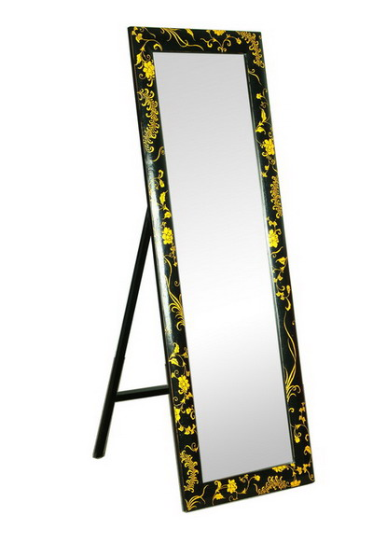
Self Reflection

Slide 23
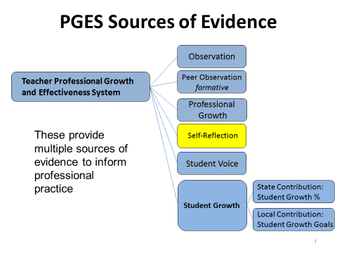

Slide 24
Self Reflection - CEP
Required every year - Fall and Spring
Reflection is on-going.
Reflective practices and professional growth planning are iterative processes.
The teacher reflects on his or her current growth needs based on multiple sources of data and identifies an area or areas for focus

Slide 25
Common Sense
Educators have always reflected. TPGES just makes it a formal activity.
When you take time to reflect you can examine what has worked and what hasn’t.

Slide 26
Self-Reflection Possibilities
The teacher decides their self reflection method. The following are just suggested possibilities. . .

Slide 27
One way . . .
Teachers could reflect on all 4 domains of the KY Framework for Teaching and the national standards in their discipline. It is from this reflection that teachers choose their growth area(s) for their PGP. It is not required that teachers have a written response for every component.

Slide 28
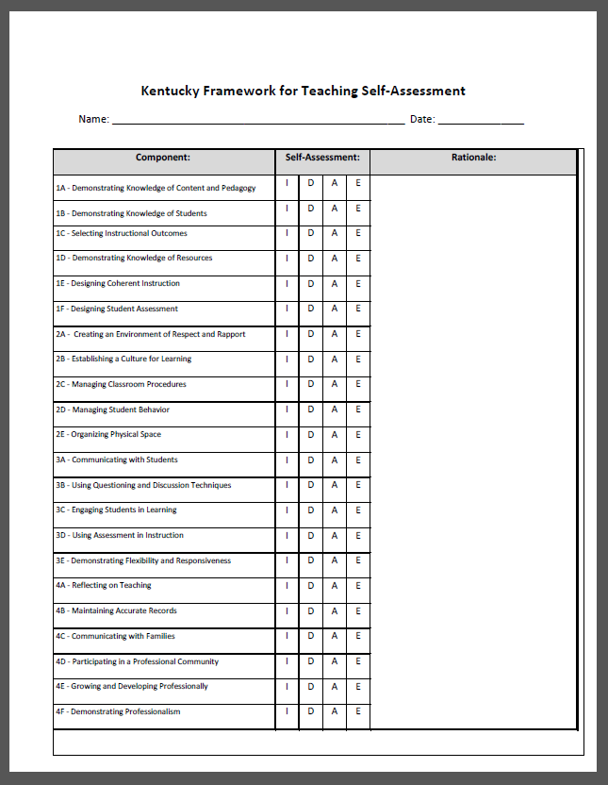
Handout

Slide 29
Use the Framework for Teaching indicators to rate yourself on the components of each of the four domains.
I= Ineffective
D= Developing
A= Accomplished
E= Exemplary

Slide 30
What do these results help me see about my teaching and/or the students' learning experience?

Slide 31
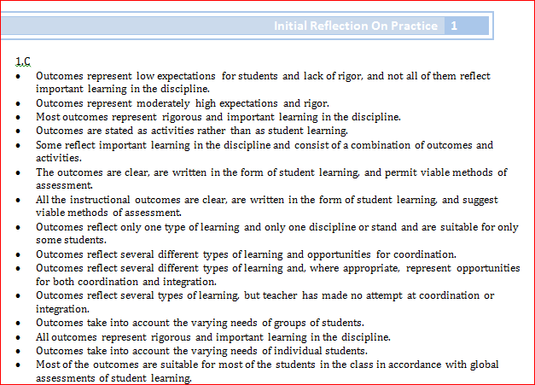
Another possibility. . .
http://education.ky.gov/teachers/HiEffTeach/Pages/PGES--Overview-Series.aspx
Step 1: Highlight or circle the descriptors in each of the four domains that
best describe your teaching practice.
Step 2: Find your highlighted descriptors in the KY Framework for Teaching.
Step 3: Determine your performance level in each of the components.
Step 4: Enter this data into EDS
Notes:
Give the self-reflection activity to each teacher to complete. Using the Initial Reflection on Practice document, an educator reflects on their teaching choosing the descriptors that best describe their teaching practices.

Slide 32
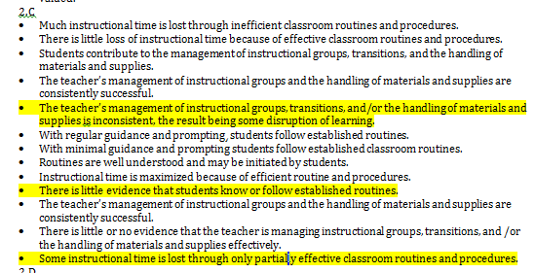

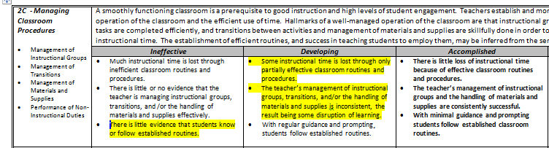
Initial Reflection on Practice
Domain 1: Planning & Preparation
Domain 2: Classroom Environment
Domain 3: Instruction
Domain 4: Professional Responsibilities
Domain 5: Student Growth
Notes:
After a teacher has chosen the descriptors that best describe their teaching practice, they then refer to the KY Framework for Teaching and find the descriptors within the performance levels in each of the components. Using this process, a teacher determines their performance level in each of the components in the framework. It is this data that will entered into EDS.

Slide 33
There is no one best way to self-reflect on your professional practice, but you should do so formally at least in the Fall and Spring (in addition to reflecting in an ongoing way throughout the year).

Slide 34
Your self-reflection is yours and does not have to be turned in to your administrator. While your administrator has to have evidence that you formally reflected, your self-reflection is primarily for YOUR use as you prepare to write and monitor your Professional Growth Goal and Plan throughout the year and work on improving as a professional educator.

Slide 35

Professional Growth
Plans

Slide 36
Professional Growth Plans
PGPs must be completed, approved, and recorded on an E2 form within 30 days of start of the work year/employment each year.
Based on the CEP, a paper copy must also be given to the employee.
Are produced in consultation with the evaluator*.
Use multiple sources of data in order to identify area(s) of focus.
PGPs provide for a goal and plan with action steps.
Employee implements the plan, monitors progress, and adjusts actions as needed based on ongoing reflection and feedback.
PGP serves as a possible source of evidence for all 4 domains.

Slide 37
3 Questions
There are 3 questions that should always be answered when creating a Professional Growth Goal and action plan:
What do I want to change about my practice that will effectively impact student learning?
How can I develop a plan of action to address my professional learning?
How will I know if I accomplished my objective?

Slide 38
During the 2015-16 school year, I will change my learning centers to reflect and support the current teaching topic instead of just having a variety of random games and activities.
Sample Professional Growth Goal (before revision)

Slide 39
Now What?
After an effective goal is written and agreed upon, the teacher must identify the learning that must take place in order to achieve that goal.
Notes:
Once a principal and teacher agrees on the professional growth goal area and the goal has been written it becomes important to identify the learning that is necessary for the teacher to accomplish the goal.

Slide 40
What new learning might the teacher need in order to implement the goal we just saw?
Take a few moments to discuss this with those around you.
Notes:
Think about the goal that we examined in the previous slide. What new learning might the teacher need in order to implement the goal we just saw? Take a minute to discuss this question at your tables.

Slide 41
What are the measures of success?
Brainstorm ways that the teacher could measure this goal.

Slide 42
During the 2015-16 school year, I will change my learning centers to reflect and support the current teaching topic instead of just having a variety of random games and activities. I will research and locate games and activities that will enhance and support my learning topics and level of difficulty. I will assess my students and provide games and activities within their zone of proximal development. I will also track the activities that my students complete and their progress. Measure of success will be the completion of the learning centers to my classroom topics and the progress charts of my students successfully completing the games and activities in the learning centers.

Slide 43
Some PGGs may focus on Domain 1 or 4
Example –
4c: Communicating with Families 5.SG Student

Slide 44
During the 2015-16 school year, I will send home a newsletter each week and send home copies of the Preschool Skills Checklist each time that I assess students. Also, I plan to make extra efforts to communicate with families with positive notes, emails, calls as well as negative when needed."

Slide 45
Moving on to Observation
(Supervisor and Peer)

Slide 46
Observation
A data collection process conducted by a certified observer, for the purpose of feedback, support, and/or evaluation, including notes, professional judgments, and examination of practices and/or artifacts made during one (1) or more classroom or worksite visits of any duration.

Slide 47
Observation Model
Minimum Requirements:
  Three mini observations (two by supervisor, one by peer) – 20 to 30 minutes
  One full observation by supervisor
  Documented on JCPS approved forms

Slide 48
Observation schedule

Slide 49
For those teachers or other professionals on a continuing (tenured) contract, the cycle is a three (3) year cycle, consisting of at least the following:
CHART 1.0 Tenured Teachers or Other Professionals
Year 1 | Mini Observation | Supervisor | Observation Window - October 1st – April 15th
Year 2 | Mini Observation | Supervisor | Observation Window - October 1st – April 15th
Year 3 – Summative | Mini Observation Full Observation | Peer Observer Supervisor | Observation Window - December 1st – February 14th Observation Window - December 1st – April 15th (no less than 15 school days after peer observation)
*Observations by evaluators must be documented on appropriate district-approved observation forms.

Slide 50
For those teachers or other professionals on a limited (non-tenured) contract or those teachers whose most recent overall performance rating places them on a one year PGP and evaluation cycle, the cycle is a one (1) year cycle, consisting of at least the following:
CHART 1.1 Non-Tenured Teachers (or Tenured Teachers or Other Professionals on One Year PGP and Summative Cycle)
Every Year | Mini Observation | Supervisor | Observation Window - October 1st – November 30th
Every Year | Mini Observation | Supervisor Peer Observer | Observation Window - December 1st – February 14th
Every Year | Full Observation | Supervisor | Observation Window - December 1st – April 15th (no less than 15 school days after peer observation)
rv
*Observations by evaluators must be documented on appropriate district-approved observation forms.

Slide 51
Peer Observation - Purpose
For teachers to receive only formative, non-evaluative feedback from a peer to help improve their practice

Slide 52
Peer Observation - Timing
-After November in one’s summative evaluation year
-No less than 15 school days prior to one’s full observation by an evaluator

Slide 53
Peer Observers
Must have a minimum of three years of teaching or other professional experience
Must complete the state-approved, peer observation training
Will have no more than 5 teachers to observe (recommendation is 3 or fewer, if possible)
Will be in the same PGES framework as the person to receive the peer observation
Peer observation must occur in the summative cycle.

Slide 54
Observation Conferencing
Pre-observation Conferences – Held 1 – 3 days prior to observation
  Is not required for supervisor observations, but may occur upon request from either the evaluator or teacher/other professional
  Pre-Observation conference required for peer observation
Post-Observation Conferences – Supervisor and Peer Observation
  In person within five working days after the observation
Summative Evaluation Conferences - held at the end of the summative cycle prior to May 1st.

Slide 55

Framework for Teaching - Domains 2 & 3
Overview and
Notes:
The comprehensive nature of teaching as described in the framework, has important implications for how teachers reflect on their practice and how they demonstrate their skill. Because much of the work of teaching happens outside the classroom, a comprehensive examination of practice cannot be restricted solely to observations of teaching.
The framework for teaching aims to describe all aspects of teaching; referring not only to what occurs in the classroom, but what occurs behind the scenes. For example:
Planning for Instruction and Next Steps – Domain 1 (Teacher gathers evidence)
Interacting with colleagues in the faculty lounge, on school and district committees, and in pursuit of instructional improvement. (Teacher gathers evidence Domain 4)
For Domains 2 and 3the supervisor gathers evidence of what they see, hear or read; primarily through observation which we just discussed.
Now let’s review Domains 2 and 3: Components, elements, critical attributes and sample evidence.
The performance levels in the FfT provide common language for teacher effectiveness that supervisors and teachers can use for discussion, evaluation and reflection.

Slide 56

Domain 2: The Classroom Environment
2A Creating an Environment of Respect and Rapport
2B Establishing a Culture For Learning
2C Managing Classroom Procedures
2D Managing Student Behavior
2E Organizing Physical Space

Slide 57
Domain 3: Instruction
3A Communicating with Students
3B Using Questioning and Discussion Techniques
3C Engaging Students in Learning
3D Using Assessment in Instruction
3E Demonstrating Flexibility and Responsiveness

Slide 58
Evidence
Bias

Slide 59
Next . . .
A Word about Student Voice*
While growing the voice of students is a very important area that can be used to inform and improve professional practice, the KY Student Voice Survey is not designed for and will not be used PK-2.

Slide 60
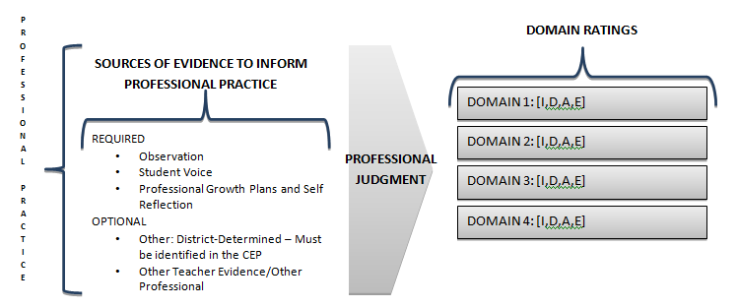
Overall PROFESSIONAL PRACTICE Rating

Slide 61
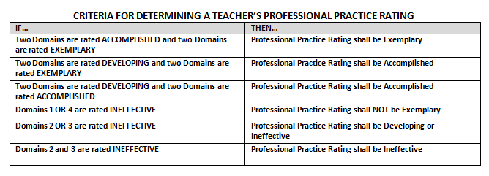
Determining Overall Professional Practice Rating

Slide 62
And Finally . . .
Student Growth

Slide 63
Student Growth
Observation
Teacher Professional Growth and Effectiveness System
Peer Observation
formative
Professional
Growth
Self-Reflection
These provide multiple sources of evidence to inform professional practice
Student Voice*
Student Growth
State Contribution:
Student Growth %
Local Contribution:
Student Growth Goals

Slide 64
Local Student Growth Goals
All K-12 teachers develop an annual local student growth goal that is approved by the principal.
Local student growth goal statements include an enduring learning (skills, concepts, or processes) from content standards that the teacher determines is an important need of students in the class.
The teacher assesses student learning of the enduring skill to establish a baseline. They formatively assess the skill over time and submit the final results to the principal so the results can be used as one component of the teacher effectiveness rating.

Slide 65
Components of a Student Growth Goal (SGG)
Timeline
Enduring Skill
Growth
Proficiency
Measurement

Slide 66

Timeline can be . . .
For the 2015-2016 school year……
During the 9-week course……
During the second trimester…..
During the 32 instructional periods this class meets for the 2015-2016 school year….

Slide 67
Important Note
  When we address the timeline, we need to remember not to extend the growth goal to the end of the school year or even to KPREP Results.
  Teachers collect and submit data to administrator by April 15.
  For Student Growth Goals written for a course lasting less than a year, remember to collect data before the course ends.

Slide 68
What is an ENDURING LEARNING
Learning that
ENDURES beyond a single test date,
is of value in other disciplines,
is relevant beyond the classroom (applying learning to new and unique situations)
is worthy of embedded, course-long focus,
may be necessary for the next level of instruction.
Requires critical thinking (analyzing, creating and evaluating)

Slide 69
How did you select the Enduring Learning?
KDE Website and the sample of Enduring Skills
Talked to other teachers
Used your expertise and experience
You looked at data
Maybe you developed a variety of assessments around all of your content’s enduring learning to see which was your student’s biggest need.
Consult your national standards and look especially at the larger, more global statements and headings for the standards.

Slide 70
Cross-Curricular Enduring Skills
Anchor Standards in reading , writing, speaking and listening are enduring skills that can be selected as enduring skills for ANY content area.

Slide 71
You have the Enduring Learning Identified.
Now What?
You need to consider the standards that defined or help to define the Enduring Learning.
You need to consider what proficiency or mastery of the Enduring Learning looks liked.
You need to be able to answer the question “Where are my students’ abilities in regard to the Enduring Learning?”

Slide 72

What is Growth?
How many students will grow?
What does growth look like?
How can growth be measured?

Slide 73
What is Proficiency?
Our Question is not only “What is Proficiency”
BUT also
What percent of our class can reach proficiency?

Slide 74
Developing a pathway toward proficiency.
Things to Consider
1. Determine proficiency for the enduring learning for the age/grade level of your students.
2. Determine the progression of standards toward proficiency.
Develop a system of continuous assessment to monitor growth
toward proficiency.

Slide 75
Writing a Student Growth Goal

Slide 76
Student Growth Goal Process
Step 1:
Determine needs
Step 2:
Create specific learning goals based on pre-assessment
Step 3:
Create and implement teaching and learning strategies
Step 4:
Monitor student progress through ongoing formative assessment
Step 5:
Determine whether students achieved the goals

Slide 77
Determine Needs
Identify the essential /enduring skills, concepts & processes for your content area for your content/grade-level standards.
Determine what mastery of those skills, concepts & processes looks like.
Pinpoint critical areas of need.

Slide 78
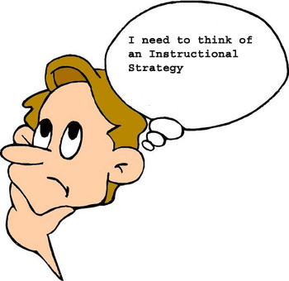
What and How do we measure a SGG?
Things to Consider…..
Knowledge - The facts and concepts we want student to know.
Reasoning - Students use what they know to reason and
solve problems.
Skills - Students use their knowledge and reasoning
to perform a task .
Products - Students use their knowledge, reasoning, and
skills to create concrete products.

Slide 79
Create SGG using a SMART process
Step 1:
Determine needs
Step 2:
Create specific learning goals based on pre-assessment
Step 3:
Create and implement teaching and learning strategies
Step 4:
Monitor student progress through ongoing formative assessment
Step 5:
Determine whether students achieved the goals

Slide 80
SMART Process
S
Specific- The goal addresses student needs within the content.
The goal is focused on a specific area of need.
M
Measurable- An appropriate instrument or measure is selected to assess the goal.
The goal is measurable and uses an appropriate instrument.
A
Appropriate- The goal is clearly related to the role and responsibilities of the teacher.
The goal is standards-based and directly related to the subject and students that the teacher teaches.
R
T
Realistic- The goal is attainable.
The goal is doable, but rigorous and stretches the outer bounds of what is attainable.
The goal is bound by a timeline that is definitive and allows for determining goal attainment.
Time-bound- The goal is contained to a single school year/course.

Slide 81
How do we measure each student’s ability in relation to the enduring skill?

Slide 82
Setting a Baseline
Multiple Assessments Around the
Enduring Skill
VS
Single Test

Slide 83
Setting A Baseline
Multiple Assessments Around the
Enduring Skill
HOW?

Slide 84
Baseline
From the pre-assessments we must ask:
  Where were my students abilities compared to the enduring skill?
  What percent of my class can I reasonably expect to reach proficiency?
  How much growth can I expect each student to make?

Slide 85

Using Multiple Sources and Kinds of Evidence
Do the sources of evidence provide the data needed to accurately measure where students are in mastering the enduring skill for the identified area of need?
Think beyond paper and pencil tests.

Slide 86
Example: Inference
Given a body of text, recognizing a correct inference (Multiple Choice)
Given a body of text, generate an acceptable inference (Constructed Response)
Improve incorrect inferences
OK
BETTER
EVEN
BETTER
Notes:
This is a slide I have used with teachers. The idea is to get teachers to understand the need to get to know their students using multiple assessments.

Slide 87
Example: Tells and Retells Story
Teacher reads a story and ask students to draw a picture of what happens in the story.
Teacher reads a story and ask questions about the story
The teacher reads a story and sees if the students can act out the story.
OK
BETTER
EVEN
BETTER

Slide 88
Student Growth Goals – Comparability and Rigor
Use of the Rigor and Comparability rubric ensures that Student Growth Goals
Are congruent with core academic standards and appropriate for the grade level and content area
Represent or encompass an enduring skill, process, understanding or concept
Allows high and low achieving students to demonstrate growth
Provides access and opportunity for all students (ECE, ESL, GT, etc.)

Slide 89
More Guidance on Student Growth Goals - CEP
The CEP contains a rubric for evaluating student growth goals (page 22).
Three SGG requirements: contains all required components or structures; includes appropriate level of rigor; data and evidence of student growth is comparable across the teacher team.
Teacher teams (PLC / Grade-Level / Group / Department) will implement a Peer Review Process to ensure rigor and comparability.

Slide 90
Peer Review SGG Processes
Teams will ensure comparable scoring processes and data collection by collaborating and reaching consensus on:
What student mastery of the enduring skills looks like using approved scoring measures identified in teacher SGG statements.
Calibration of scoring, to ensure consistency using the measures/rubrics in the SGG statements (to determine baseline, interim growth data, and student progress to mastery)

Slide 91
JCPS Rubric for Student Growth Goals - CEP
Structure of the Goal
Requirements: The Student Growth Goal | is acceptable if it . . . | needs revision if it. . .
Focuses on a standards-based enduring skill which students are expected to master. | focuses on a standards-based enduring skill. | Contains a skill that is not standards-based or does not match enduring skill criteria.
Identifies an area of need pertaining to current students’ abilities. | identifies a specific area of need related to the enduring skill, supported by evidence for current students. | does not identify a specific area of need or the area of need is not related to the enduring skill.
Includes growth and proficiency targets that establish and differentiate expected performance for ALL students. | includes a growth target for ALL students and a proficiency target that establishes the mastery expectation for students. | is missing one of the targets or fails to differentiate expected performance for one or both targets.
Identifies appropriate sources and kinds of evidence for base-line, mid-course, and end-of-year/course data collection. | identifies appropriate sources and kinds of evidence for collecting baseline, mid-course, and end-of-year/course data that matches the skill being assessed. | fails to identify appropriate sources and kinds of evidence for data collection, or they are not well-matched to the skill being assessed.
Explicitly states year-long/course-long interval of instruction. | specifies a year-long/course-long interval of instruction. | fails to specify an interval of instruction, or the interval is less than year-long/course-long.
Rigor of the Goal and Sources and Kinds of Evidence
Requirements: The rigor of the Student Growth Goal | is acceptable if it . . . | needs revision if it. . .
It Is congruent to KCAS grade level/content area standards for which it was developed. | is congruent and appropriate for grade level/content area standards | is congruent to content but not to grade level standards, or it is not congruent
The growth and proficiency targets are challenging for students, but attainable with support. The identified sources and kinds of evidence of learning/growth allow for students to demonstrate where they are in meeting or exceeding the intent of the standards in which the enduring skill is being assessed. | has growth and proficiency targets that are doable, but stretch the outer bounds of what is attainable. has identified sources and kinds of evidence that allow students to demonstrate their competency in performing at the level intended by the standards in which the enduring skill is being assessed. | has growth and proficiency targets that are not achievable or the targets are achievable, but fail to stretch attainability expectations has identified sources and kinds of evidence that only allow students to demonstrate competency of a portion or none of the aspects intended by the standards being assessed in which the enduring skill is being assessed.
Comparability of Data and Evidences of Student Learning/Growth
Requirements: The comparability of the Student Growth Goal | is acceptable if it. . . | needs revision if . . .
Uses comparable criteria across similar classrooms (addressing the same standards) to determine progress toward mastery of the standards-based enduring skill being assessed | reflects collaborative development of common criteria (sources and kinds of evidence/rubrics) to determine competency in performance at the level intended by the standards in which the enduring skill is being assessed. | it does not reflect common criteria used to determine progress.

Slide 92

What is RIGOR and why is it critical to writing a quality Student Growth Goal?
Finding the SWEET SPOT

Slide 93
Can rigor be too high or too low?
What happens when learning gets out of reach for a student?
What happens when students are not challenged?
How do you achieve the “Goldilocks Effect”?
Discuss with your elbow partner.

Slide 94
A SGG is Rigorous when……..
Difficult enough (Goldilocks effect)
Rigor refers to the SGG and not the standard(s)
The SGG is congruent to the standard(s)
I recognize student work at the appropriate level
Do I provide opportunities for my students to demonstrate skills and abilities at the appropriate level?

Slide 95
Writing the Goal
During the Time Period, 100% of my students will demonstrate measurable growth in Enduring Learning. This will be evident as students will grow # performance level(s) on the Title rubric.
% of my students will reach proficiency. This will be evident by students demonstrating learning at the Level on the rubric.

Slide 96
Sample Student Growth Goal
Using the 8 standards for mathematical practice, all of my 3rd grade math students will develop their ability to understand multiplication and division conceptually over the course of the school year. All students will grow at least one level on the 3rd grade critical area standards mastery rubric and 80% of students will reach proficiency (level 4 on the rubric).
REVISED during initial conferencing: Using the 8 standards for mathematical practice, all of my 3rd grade math students will develop their ability to understand multiplication and division conceptually over the course of the school year. All students will grow at least TWO levels on the 3rd grade critical area standards mastery rubric and 70% of students will reach proficiency (level 4 on the rubric).

Slide 97
Elementary
During the 2015-2016 school year, all students will improve comprehension through application of phonics, word recognition and fluency to grade-level texts. Each student will meet their DIBELS benchmark, Reading Inventory goals, and improve by one or more levels on the teacher-generated rubric for reading comprehension. 85% of students will be reading on grade level by year end as measured by their reading comprehension rubric.

Slide 98
Social Studies – What’s Realistic?
During this school year, 100% of my students will increase his/her ability to identify credible sources. Each student will increase his/her ability to analyze the accuracy of information and distinguish fact/opinion/reasoned judgment by at least one performance level in all areas of the district social studies standards rubric. Furthermore, 75% of students will score at “proficient” or above.
Can you identify the growth target and the proficiency target?

Slide 99
Social Studies – What’s Realistic?
During this school year, 100% of my students will increase his/her ability to identify credible sources. Each student will increase his/her ability to analyze the accuracy of information and distinguish fact/opinion/reasoned judgment by at least one performance level in all areas of the district social studies standards rubric. Furthermore, 75% of students will score at “proficient” or above.
Growth
Proficiency

Slide 100
Supervisors will approve the teacher-developed and peer-reviewed Student Growth Goal.
This process will be completed by October 16 for 2015-16.

Slide 101
Rating the Local SGG and
Determining the Overall SGG Rating

Slide 102
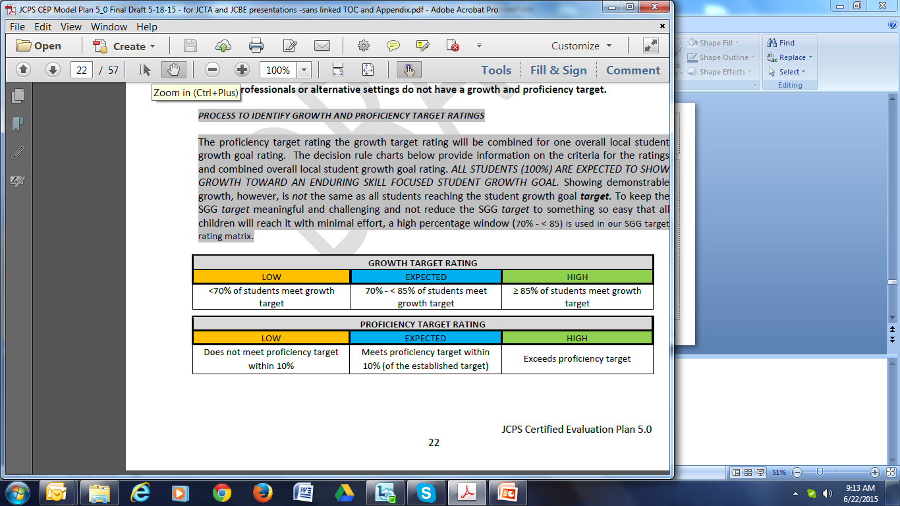

Slide 103
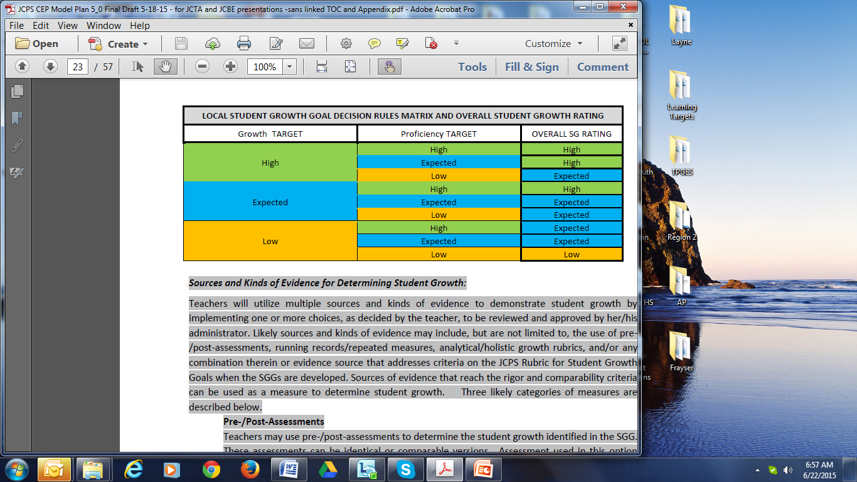

Slide 104
PROFESSIONAL
PRACTICE
STUDENT GROWTH
OVERALL PERFORMANCE

Slide 105
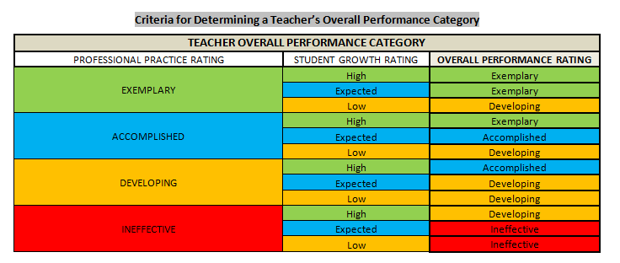
Determining Overall Performance Category

Slide 106
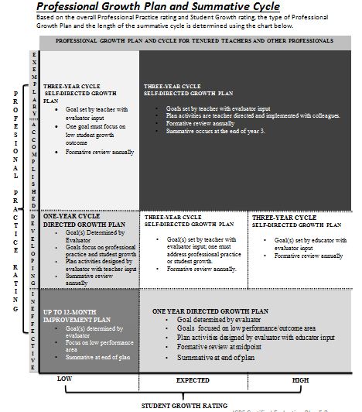

Slide 107
If Professional Practice Rating is this: | and, if Student Growth Rating is this: | then: | and then this:
Exemplary or Accomplished | High or Expected | 3 yr. self-directed cycle | Goals set by teacher with evaluator input. Plan activities are teacher directed and implemented with colleagues. Formative review annually. Summative occurs at the end of year 3.
 | Low | 3 yr. self-directed cycle | Goal set by teacher with evaluator input. One goal must focus on low student growth outcome. Formative review annually.
Developing | High | 3 yr. self-directed cycle | Goal(s) set by educator with evaluator input. Formative review annually.
 | Expected | 3 yr. self-directed cycle | Goal(s) set by teacher with evaluator input; one must address professional practice or student growth. Formative review annually.
 | Low | 1 yr. directed cycle | Goal(s) determined by evaluator. Goals focus on professional practice and student growth. Plan activities designed by evaluator with teacher input. Summative review annually.
Ineffective | High or Expected | 1 yr. directed cycle | Goal determined by evaluator. Goals focused on low performance/outcome area. Plan activities designed by evaluator with educator input. Formative review at midpoint. Summative at end of plan.
 | Low | Up to 12 month improvement plan | Goal(s) determined by evaluator. Focus on low performance area. Summative at end of plan.

Slide 108
Intensive Support
At any time, when significant deficiencies in work performance have been observed, an employee may be placed on Intensive Support, as specified in the JCBE-JCTA labor agreement.
At that time the district-designed process will be instituted which includes a specific timeline for observations, support and conferences.
At the end of the specified timeline, the evaluator will provide a written summary of the conferences to the employee.

Slide 109
NEW
Appeal Process - JCPS
Local Evaluation Appeals Panel (LEAP)
Review and/or hear appeals from certified employees regarding their summative evaluations
Pool of Employees – 18 certified employees
Twelve certified employees elected from employees eligible for JCTA membership
Six certified employees appointed by the superintendent/designee
Panel – 3 certified employees
One member chosen from the 6 appointed by superintendent/designee
Two members chosen from the 12 elected from employees eligible for JCTA membership

Slide 110
Questions?

